Slide 1
Movies Analysis for Microsoft
Analysis by shradha waddepalli

Slide 2
Summary
From ten database, I sifted through tables to examine the information provided. I used five tables for my project. After inspecting, the quality of data, I realised the need to clean data to plan my future moves towards analysis.
Taking advantage of the data present in each table I cleaned and joined them. Using some statistical methods and graphs to show top performing movies. These movies represent top performing genre’s.
My second and third recommendations were extracted in few steps. I am required to Join & merge using some panda conditional data extraction methods to be able to finalise list of writers and directors.

Slide 3
Business Problem
Microsoft is aiming to create new movie studio. They require recommendations on the type of movies doing well at Box office. Recommendations include actionable insights to help Microsoft with new movie studio.

Slide 4
Data
Upon sifted through the datasets, I noticed that, out of ten different tables in CSV and JSON format, I can use five tables to extract desired data.
bom.movie_gross.csv.
imdb.title.crew.csv.
imdb.title.principals.csv.
imdb.title.basics.csv.
imdb.name.basics.csv.gz

Slide 5
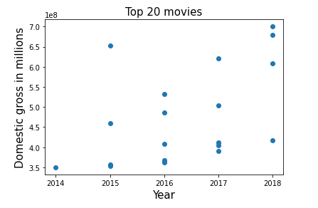
Methods
I used “bom.movie_gross” dataset to extract highest domestic gross within 2014 to 2018 by using .sort and .loc method. I narrowed down the list to top 20. Plotted scatter plot by importing Matplotlib showing highest grossed movies in each year.

Slide 6
Joining “imdb.title.basics” with my top 20 movies dataset, I was able to extract Genre’s data. Which formed my recommendation 1-Top Genre.
Employing .isin function to extract data relating to the top 20 movies, which include “tconst” and “Primary Title”
Merging 'imdb.title.crew.csv’ to newly extracted data table provided with Directors and Writers coded names.
Again, left merging 'imdb.name.basics.csv’. On “directors” and “nconst” as respective indexes. I obtained the corresponding names of the coded directors, by using .dropna(subset) method. Hence forming my recommendation 2 – Top Directors list.
getting to my third recommendation was a bit of work. I extracted data from my top 20 movie list & “imdb.title.principals.csv” by left merging on “ncont” to get an individual list of writers forming my recommendation 3- Top writers

Slide 7
Recommendation -1. Genre
Microsoft should aim to produce a movie within following genres. These movies have been performing very well at the box office.
Crime | Drama
Animation | Adventure
Action | Sci-Fi
Fantasy | Thriller

Slide 8
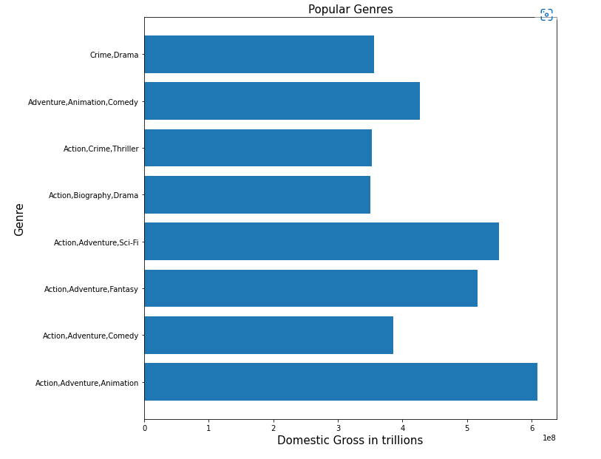
Popular Genres

Slide 9
Recommendation -2. Director
Microsoft should produce movies with either of following Directors.
Colin Trevorrow | Clint Eastwood | James Wan | J.A. Bayona
Patty Jenkins | Jake Kasdan | Brad Bird
Tim Miller | Joss Whedon | Gareth Edwards
Ryan Coogler | Rian Johnson | James Gunn

Slide 10
Recommendation -3. Writer
Microsoft should get the stories written by either of following Writers or combination of writers
1 | Joe Robert Cole | 16 | John Knoll
2 | Stan Lee | 17 | Gary Whitta
3 | Jack Kirby | 18 | Victoria Strouse
4 | Jack Kirby | 19 | Bob Peterson
5 | Christopher Markus | 20 | Stan Lee
6 | Stephen McFeely | 21 | Jack Kirby
7 | Stan Lee | 22 | Joe Simon
8 | Rick Jaffa | 23 | Jim Starlin
9 | Amanda Silver | 24 | Derek Connolly
10 | Derek Connolly | 25 | Colin Trevorrow
11 | Michael Crichton | 26 | Michael Crichton
12 | George Lucas | 27 | Harry G. Peter
13 | George Lucas | 28 | Allan Heinberg
14 | Chris Weitz | 29 | Zack Snyder
15 | Tony Gilroy | 30 | Jason Fuchs

Slide 11
Results Recommendation -3. Writer
31 | William Moulton Marston | 46 | Cinco Paul
32 | Jack Kirby | 47 | Ken Daurio
33 | Christopher Markus | 48 | Brian Lynch
34 | Stephen McFeely | 49 | Rhett Reese
35 | Joe Simon | 50 | Paul Wernick
36 | Chris Van Allsburg | 51 | Dylan Schaffer
37 | Chris McKenna | 52 | Chris Morgan
38 | Erik Sommers | 53 | Gary Scott Thompson
39 | Scott Rosenberg | 54 | Jason Hall
40 | Jeff Pinkner | 55 | Chris Kyle
41 | Jim Starlin | 56 | Scott McEwen
42 | Dan Abnett | 57 | Jim DeFelice
43 | Andy Lanning
44 | Steve Englehart
45 | Steve Gan

Slide 12
Thank You!
Email: shradha.waddepalli@gmail.com
GitHub: @shrwad

